Slide 1
National Aviation Academy of the Philippines
Institute of Computer Studies
Faculty Evaluation System
Researchers:
Lewis, Dannica
Aldos, Dannie
Teodore, Mia
March 12, 2026

Slide 2
Chapter 1 : Introduction
National Aviation Academy of the Philippines
Institute of Computer Studies
Research Gap | Research Problem | Research Questions
Most digital faculty evaluation systems merely automate paper-based surveys without strengthening authentication, data integrity, or analytical depth. Qualitative feedback is often collected but not processed using AI-driven summarization or sentiment analysis, limiting actionable insights. Additionally, few studies comprehensively evaluate such systems using international standards like ISO/IEC 25010. There is also limited empirical evidence on the cost–benefit impact of AI-enhanced evaluation systems in CHED-regulated institutions. | Current faculty evaluation systems in many higher education institutions remain limited in terms of security, analytical capability, and standards-based quality assessment. The absence of robust authentication mechanisms and structured AI-driven analysis compromises data reliability and reduces the value of qualitative feedback. Additionally, many systems are not systematically evaluated using internationally recognized frameworks such as ISO/IEC 25010, resulting in gaps in technical validation. Consequently, institutions face challenges in ensuring secure, efficient, and evidence-based faculty performance assessment. | RQ1: What is the relationship between evaluator authentication mechanisms and the perceived reliability of faculty evaluation results?
 |  | RQ2: How does the use of AI-driven summarization and sentiment analysis influence the interpretability and usefulness of qualitative faculty feedback?
 |  | RQ3: To what extent do faculty evaluation systems comply with international software quality standards such as ISO/IEC 25010, and how does this compliance affect overall system effectiveness?
 |  | RQ4: What factors significantly influence user satisfaction, trust, and acceptance of AI-enhanced faculty evaluation systems in higher education institutions?
 |  | RQ5: What suggestions and recommendations do students, faculty members, and administrators provide to improve the security, analytical features, usability, and overall effectiveness of AI-enhanced faculty evaluation systems?

Slide 3
Chapter 1 : Project Context
National Aviation Academy of the Philippines
Institute of Computer Studies
Existing System
  Manual and basic online forms used for faculty evaluation
  Limited identity validation and manual report consolidation
  No structured AI analysis or formal quality assessment
Gaps and Risks
  Risk of unreliable or unauthorized submissions
  Underutilized qualitative feedback
  No compliance evaluation with ISO/IEC 25010
Need for Innovation and Standard
  Secure authentication and AI-driven analytics
  ISO-aligned quality evaluation framework
  Efficient, data-driven, and sustainable evaluation system

Slide 4
Chapter 1 : Purpose and Description
National Aviation Academy of the Philippines
Institute of Computer Studies
Project Purpose
  To evaluate and examine an AI-enhanced faculty evaluation system that improves security, analytical capability, and standards-based quality compliance in higher education.
System Components
  Secure enrollment-based authentication
  AI-driven summarization and sentiment analysis
  Automated reporting and analytics dashboard
  Quality evaluation aligned with ISO/IEC 25010
Expected Benefits
  Improved data reliability and evaluation integrity
  Actionable insights from qualitative feedback
  Enhanced usability, efficiency, and decision-making support
  Evidence-based recommendations for institutional improvement

Slide 5
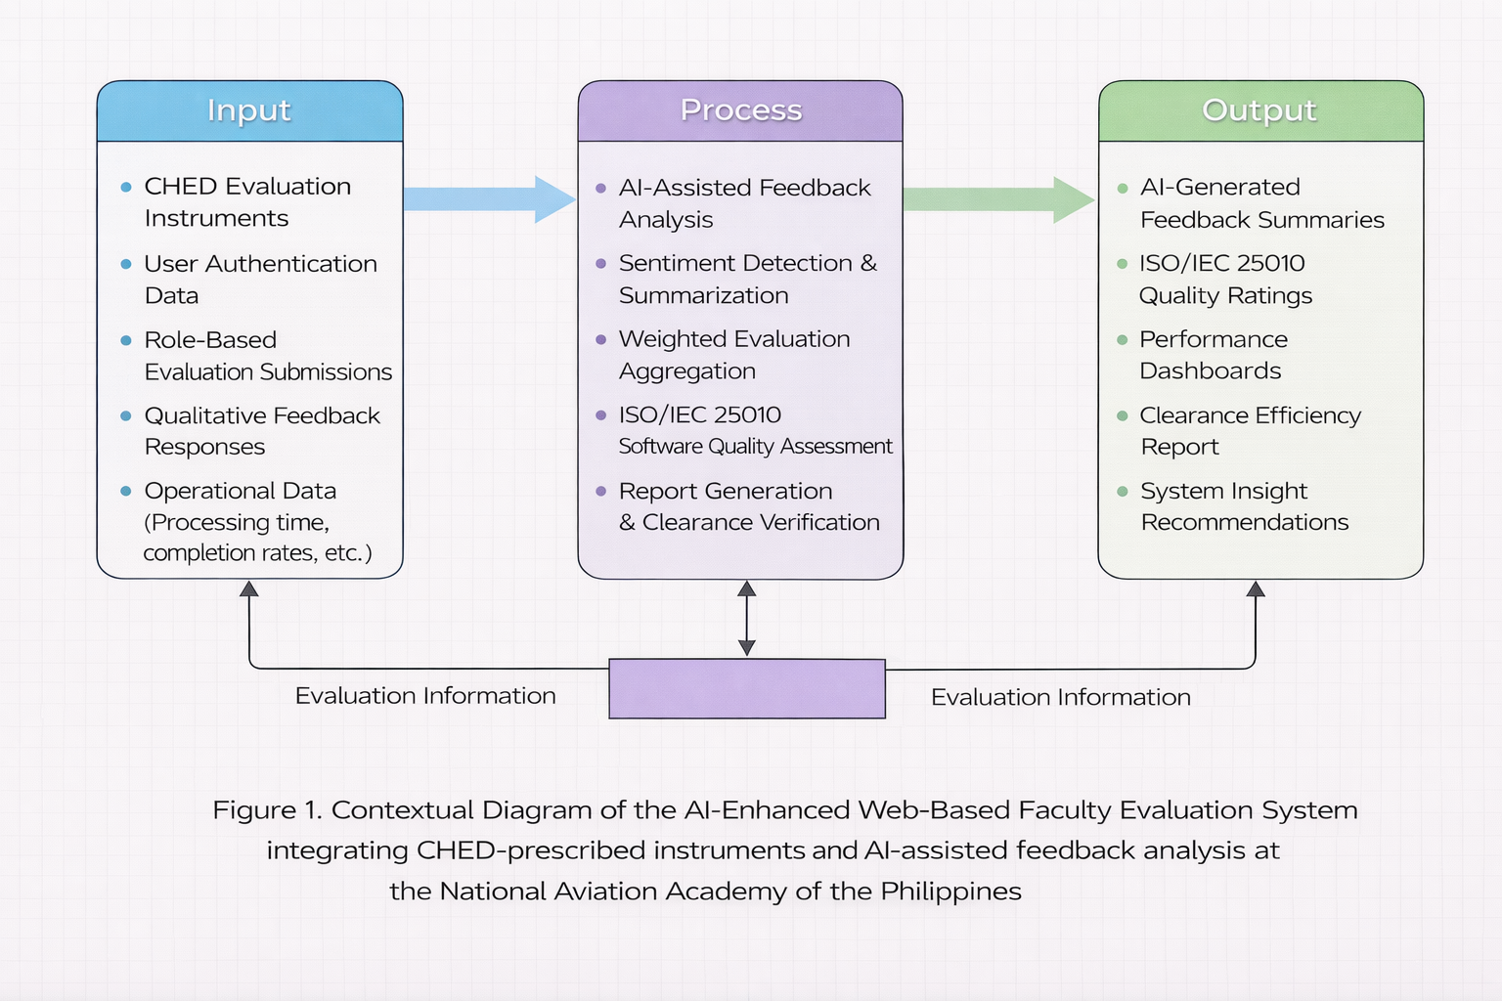
Chapter 1 : Contextual Diagram
National Aviation Academy of the Philippines
Institute of Computer Studies

Slide 6
Chapter 1 : Objectives
National Aviation Academy of the Philippines
Institute of Computer Studies
General Objective
To empirically examine the security, analytical capability, software quality compliance, usability, and overall effectiveness of AI-enhanced faculty evaluation systems in higher education institutions.
Research Questions | Research Objectives
RQ1 | To determine the relationship between evaluator authentication mechanisms and the perceived reliability of faculty evaluation results.
RQ2 | To assess how AI-driven summarization and sentiment analysis influence the interpretability and usefulness of qualitative feedback.
RQ3 | To evaluate the extent of compliance of faculty evaluation systems with ISO/IEC 25010 characteristics and its effect on overall system effectiveness.
RQ4 | To identify the factors influencing user satisfaction, trust, and acceptance among students, faculty, and administrators.
RQ5 | To gather respondent-based suggestions and recommendations for improving the security, usability, analytical capability, and sustainability of AI-enhanced faculty evaluation systems.

Slide 7
Chapter 1: Scope and Limitations
National Aviation Academy of the Philippines
Institute of Computer Studies
Scope
  Examines AI-enhanced faculty evaluation systems in a higher education context
  Focuses on security, AI-driven qualitative analysis, usability, and ISO-aligned quality compliance
  Includes students, faculty, and administrators as respondents
  Uses survey-based evaluation and selected ISO/IEC 25010 characteristics
Limitations
  Limited to one institution and one evaluation period
  Focuses only on faculty evaluation (excludes other assessment systems)
  AI analysis confined to summarization and sentiment detection
  Cost–benefit findings based on short-term data

Slide 8
Chapter 2: Review of Related Literature
National Aviation Academy of the Philippines
Institute of Computer Studies
Security, AI Analytics, and Software Quality
  1. Authentication and Data Integrity
    Secure authentication improves trust and reliability of information systems [1].
    System success depends on information quality and system integrity [2].
  2. AI-Driven Qualitative Feedback Analysis
    Sentiment analysis enhances interpretation of textual feedback [3].
    NLP-based summarization improves decision-support efficiency [4].
  3. Software Quality Standards
    ISO/IEC 25010 defines functional suitability, reliability, security, usability, and performance efficiency [5].

Slide 9
Chapter 2: Review of Related Literature
National Aviation Academy of the Philippines
Institute of Computer Studies
Usability, Acceptance, and Institutional Value
  4. Usability and User Satisfaction
    Perceived usefulness and ease of use influence system adoption [6].
    User satisfaction is a key determinant of IS success [2].
  5. Technology Acceptance and Trust
    Trust and perceived reliability significantly affect acceptance of digital systems [7].
  6. Cost–Benefit and Sustainability
    Information systems generate organizational value when aligned with performance and efficiency metrics [8].

Slide 10
Chapter 3: Technical Background
National Aviation Academy of the Philippines
Institute of Computer Studies
Research & Development Methodology
Methodology Overview
  Adopted Agile (Scrum-inspired) SDLC
  Iterative development with stakeholder feedback
  Ensures adaptability to CHED policies and institutional changes
Agile Phases
  Requirements Analysis & Planning
  System Design
  Development & Implementation
  Testing & Evaluation
  Deployment & Maintenance

Slide 11
Chapter 3: Technical Background
National Aviation Academy of the Philippines
Institute of Computer Studies
Analysis of Existing System & Gap
Current System
  Manual and semi-digital evaluation (external survey tools)
  Manual consolidation and clearance verification
  No AI-based qualitative analysis
  Limited system integration
Identified Gaps
  Risk of duplicate/unauthorized submissions
  Administrative workload and delays
  Decentralized data storage
  No automated qualitative feedback processing

Slide 12
Chapter 3: Technical Background
National Aviation Academy of the Philippines
Institute of Computer Studies
Proposed System Architecture
Architecture Type
  Web-based Client–Server Model
  Three-Layer Architecture:
    Presentation Layer (User Interface)
    Application Layer (Processing + AI Module)
    Data Layer (Centralized Database)
Core Modules
  Evaluation Management
  Authentication & Access Control
  AI Feedback Analysis
  Reporting & Dashboard
  Clearance Monitoring
  Administrative Management

Slide 13
Chapter 3: Technical Background
National Aviation Academy of the Philippines
Institute of Computer Studies
Feasibility & Cost–Benefit Summary
Feasibility Analysis
  ✔ Technical (Existing server infrastructure sufficient)
  ✔ Operational (Aligned with current workflows)
  ✔ Economic (Positive ROI)
  ✔ Schedule (Agile iterative timeline)
Cost–Benefit (3 Years)
  Total Cost: ₱590,000
  Total Benefit: ₱750,000
  Net Benefit: ₱160,000
  ROI: 27.12%

Slide 14
Chapter 3: Technical Background
National Aviation Academy of the Philippines
Institute of Computer Studies
Security, Data Privacy & Technology Stack
Security Measures
  Role-based authentication
  Encrypted data transmission
  Audit logging & activity monitoring
  Compliance with RA 10173 (Data Privacy Act)
Technology Stack
  Web-based programming framework
  Relational Database (RDBMS)
  AI-assisted text analysis (frequency-based summarization)
  Institutional server deployment

Slide 15
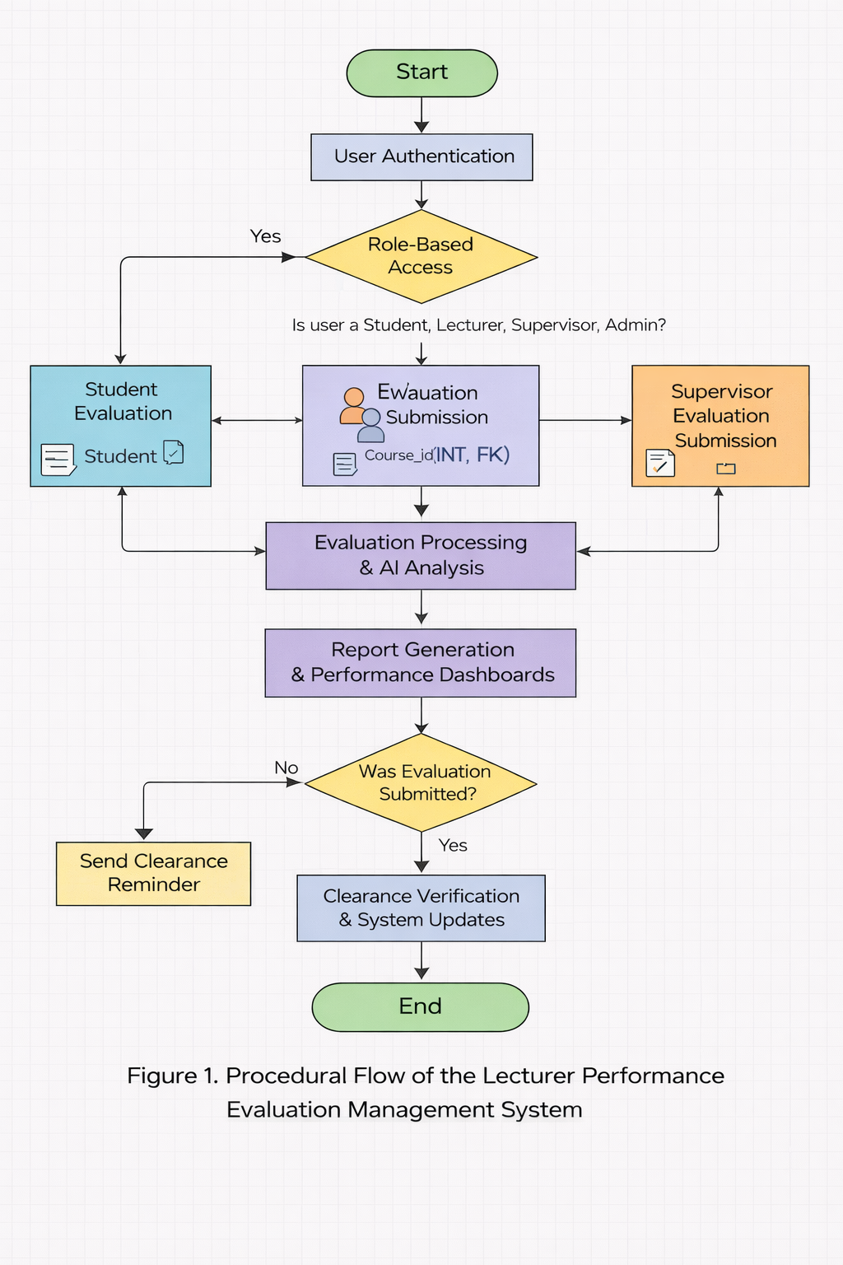
Chapter 3: Technical Background
National Aviation Academy of the Philippines
Institute of Computer Studies
Procedural Flow

Slide 16
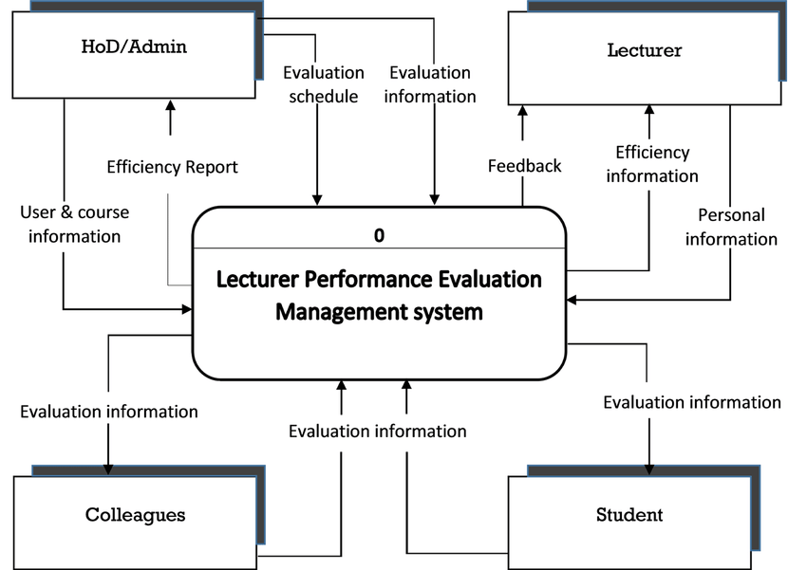
Chapter 3: Technical Background
National Aviation Academy of the Philippines
Institute of Computer Studies
Data Flow Diagram Level 0

Slide 17
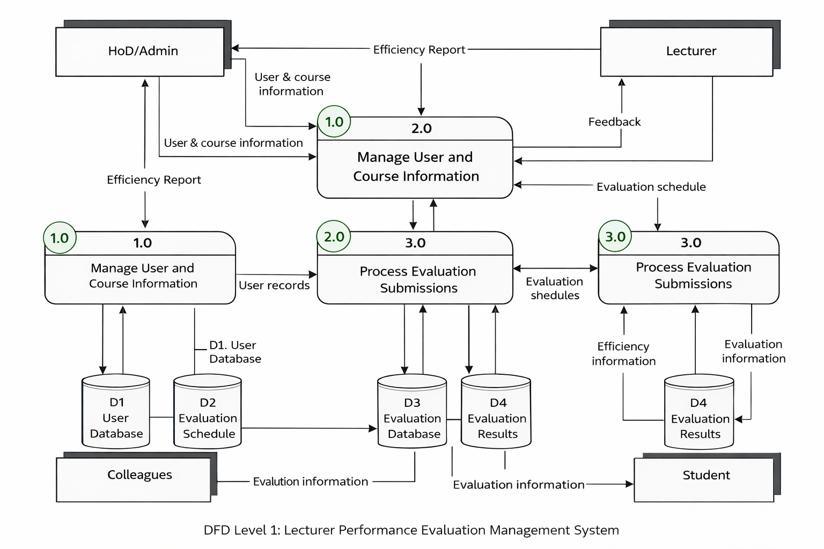
Chapter 3: Technical Background
National Aviation Academy of the Philippines
Institute of Computer Studies
Data Flow Diagram Level 1

Slide 18
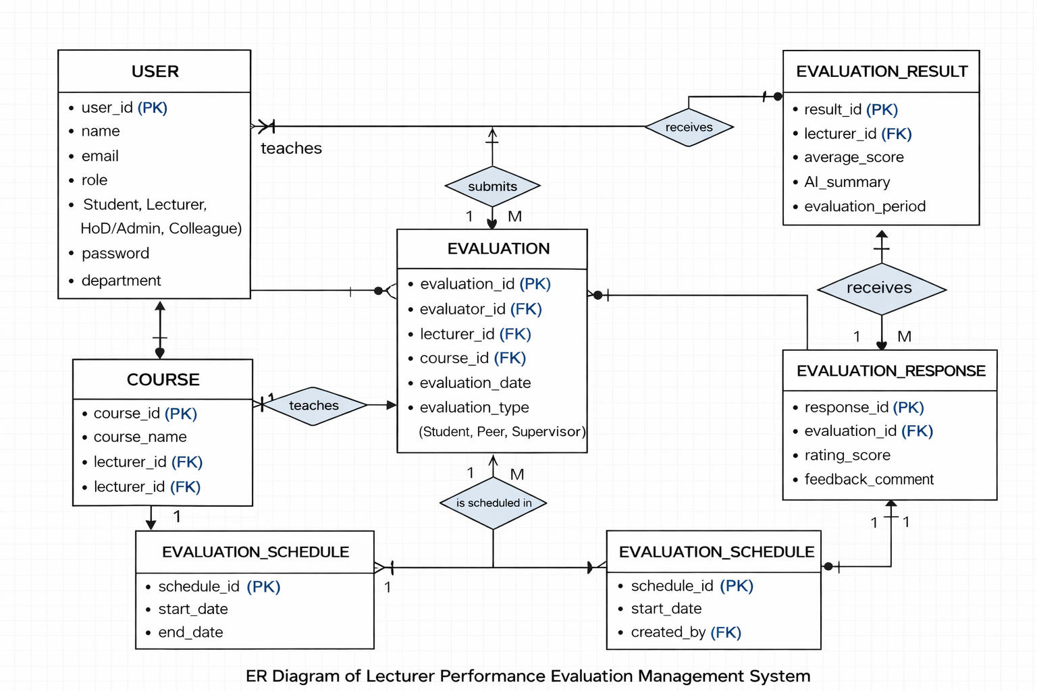
Chapter 3: Technical Background
National Aviation Academy of the Philippines
Institute of Computer Studies
Entity Relationship Diagram

Slide 19
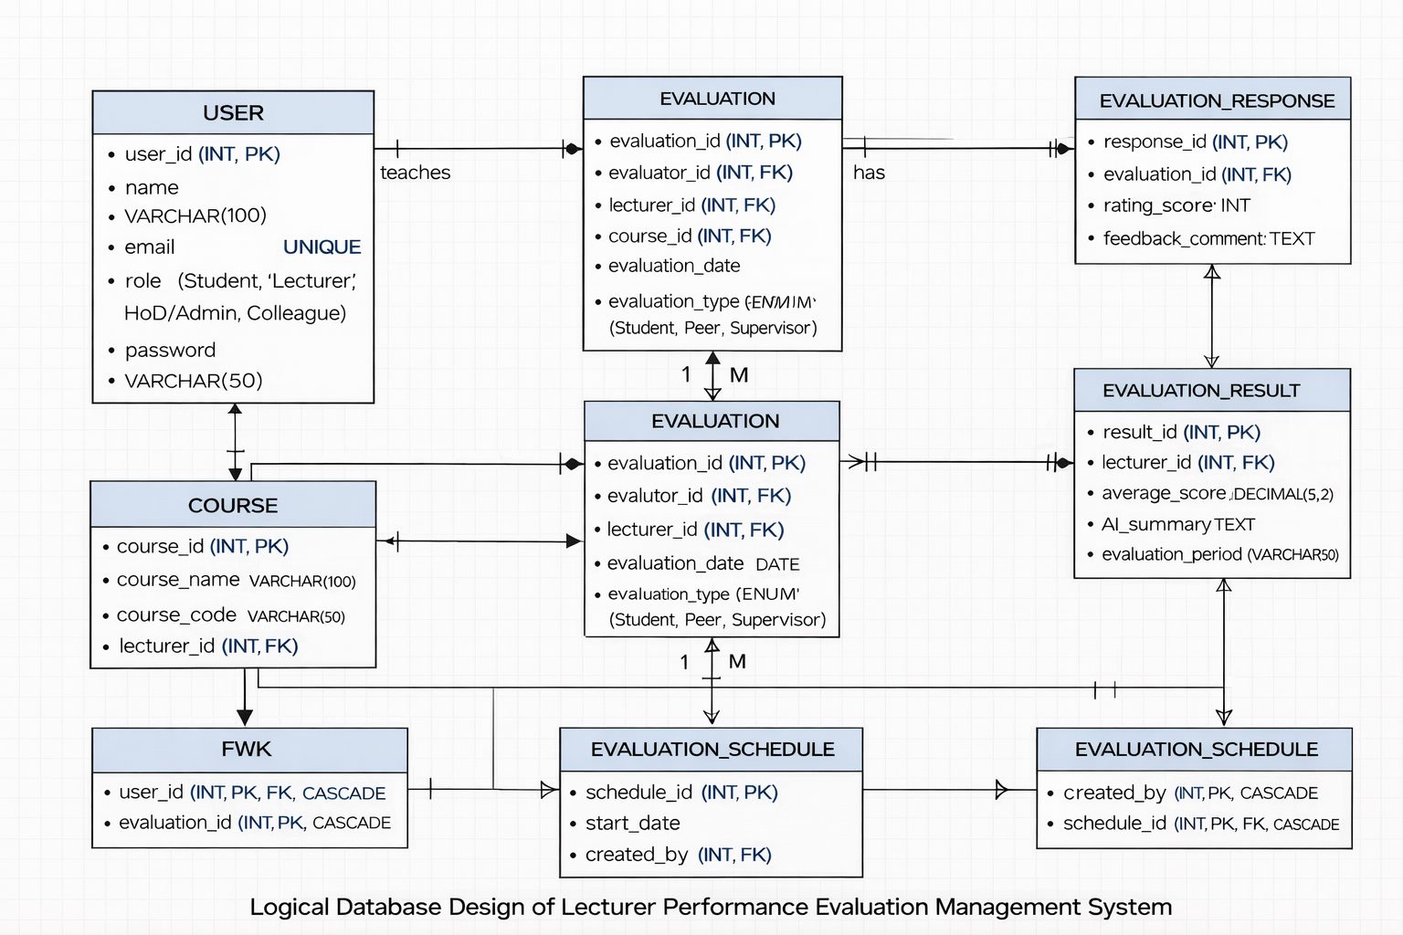
Chapter 3: Technical Background
National Aviation Academy of the Philippines
Institute of Computer Studies
Logical Database Design

Slide 20
Chapter 4: Research Methodology
National Aviation Academy of the Philippines
Institute of Computer Studies
Research Design
  This study employed a Design Science Research (DSR) framework combined with a mixed-method evaluative research design to examine the effectiveness, quality compliance, usability, and institutional impact of the AI-Enhanced Web-Based Faculty Evaluation System. The methodology was aligned with the study objectives, which focused on knowledge generation regarding system security, AI-assisted qualitative analysis, ISO-based software quality compliance, user acceptance, and respondent-driven recommendations.
  The DSR approach supported the systematic development and evaluation of the system as a technological artifact, while the mixed-method design enabled comprehensive empirical validation using both quantitative and qualitative data. Quantitative methods were used to measure system quality, reliability, and operational efficiency. Qualitative methods were used to examine user perceptions, AI-generated summaries, and stakeholder recommendations.

Slide 21
Chapter 3: Research Methodology
National Aviation Academy of the Philippines
Institute of Computer Studies
Methodology Mapping
Research Objective | Data Source | Data Gathering Method | Statistical / Analytical Technique | Expected Output
1. Examine relationship between authentication mechanisms and evaluation reliability | System logs, user perception survey | Log analysis, structured Likert-scale survey | Mean, Standard Deviation, Variance comparison | Level of perceived data reliability and authentication effectiveness
2. Assess effectiveness of AI-driven summarization and sentiment analysis | Open-ended evaluation comments, AI-generated summaries | AI text processing + manual thematic validation | Keyword frequency analysis, Thematic analysis, Mean perception rating | Accuracy, usefulness, and interpretability of AI outputs
3. Evaluate compliance with ISO/IEC 25010 quality characteristics | Post-use system quality survey | ISO-based structured questionnaire | Weighted Mean, Standard Deviation, Cronbach’s Alpha | Quality rating across functional suitability, usability, security, reliability, performance
4. Identify factors influencing user satisfaction and system acceptance | User perception survey (students, faculty, supervisors, HR) | Post-implementation survey | Mean comparison, Percentage distribution | Usability level, trust, satisfaction, acceptance factors
5. Gather respondent-based suggestions and recommendations | Open-ended survey responses | Qualitative feedback collection | Thematic categorization, Frequency count | Consolidated improvement recommendations

Slide 22
References
National Aviation Academy of the Philippines
Institute of Computer Studies
References
[1] S. Furnell and N. Clarke, “Power to the people? The evolving recognition of human aspects of security,” Computers & Security, vol. 31, no. 8, pp. 983–988, 2012.
[2] W. H. DeLone and E. R. McLean, “The DeLone and McLean model of information systems success: A ten-year update,” Journal of Management Information Systems, vol. 19, no. 4, pp. 9–30, 2003.
[3] B. Liu, Sentiment Analysis and Opinion Mining. San Rafael, CA, USA: Morgan & Claypool, 2012.
[4] K. Sparck Jones, “Automatic summarising: The state of the art,” Information Processing & Management, vol. 43, no. 6, pp. 1449–1481, 2007.
[5] ISO/IEC 25010:2011, Systems and Software Engineering—Systems and Software Quality Requirements and Evaluation (SQuaRE)—System and Software Quality Models, International Organization for Standardization, 2011.
[6] F. D. Davis, “Perceived usefulness, perceived ease of use, and user acceptance of information technology,” MIS Quarterly, vol. 13, no. 3, pp. 319–340, 1989.
[7] D. Gefen, E. Karahanna, and D. W. Straub, “Trust and TAM in online shopping,” MIS Quarterly, vol. 27, no. 1, pp. 51–90, 2003.
[8] E. Brynjolfsson and L. Hitt, “Beyond computation: Information technology, organizational transformation and business performance,” Journal of Economic Perspectives, vol. 14, no. 4, pp. 23–48, 2000.

Slide 23
Q & A
National Aviation Academy of the Philippines
Institute of Computer Studies

Slide 24
Thank You!
National Aviation Academy of the Philippines
Institute of Computer Studies

